Slide 1
Unit 3B
Human Diversity & Change
Variation & evolution
Primate evolutionary trends

Slide 2

Study Guide
Read:
Chapter 17 Human Perspectives 7th edition.

Slide 3
Classification of Primates
Primates
Prosimians
Anthropoids
Lemuriformes
Tarsiiformes
Platyrrhines
Catarrhines
Lemurs
Lorises
Tarsiers
Ceboids
New World monkeys
Cercopithecoids
Old World monkeys
Hominoids
apes & man
Notes:
Formes refers to ‘like’. Lemuriformes therefore look like lemurs. Rhines refers to nose (remember rhinocerus ‘horn on nose’)

Slide 4
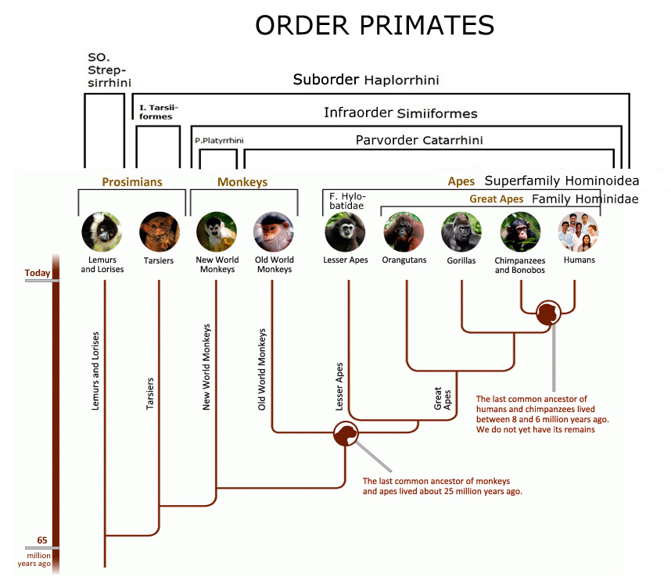
Other classification charts.
Notes:
There are different methods of classification. Another is on p.255 in your text book.

Slide 5
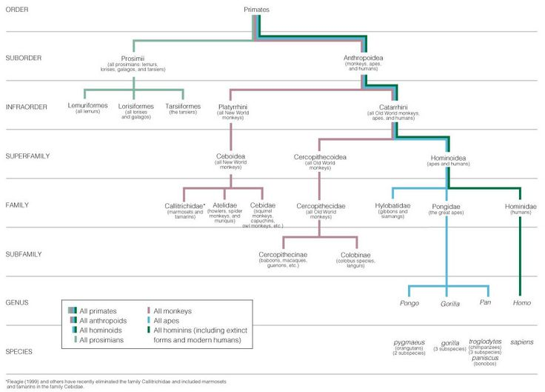

Slide 6
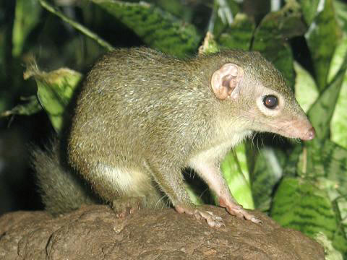
Ancestral primate
Tupaia – the oriental tree shrew
Stavenn
Notes:
The tree shrew was initially thought to be a primitive primate but is not anymore. It looks cute though.

Slide 7
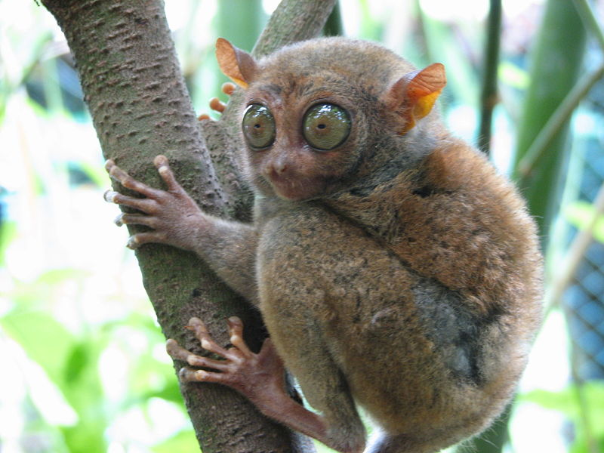
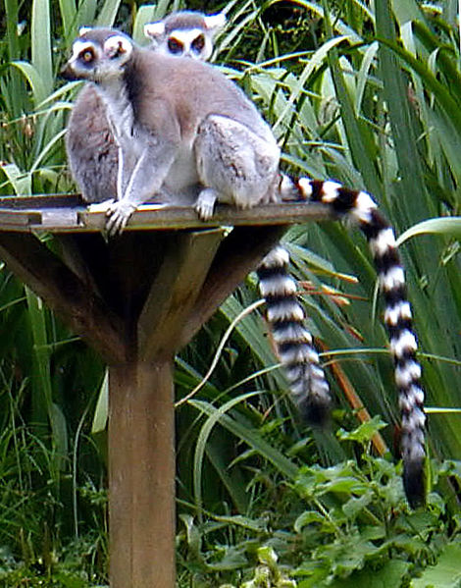
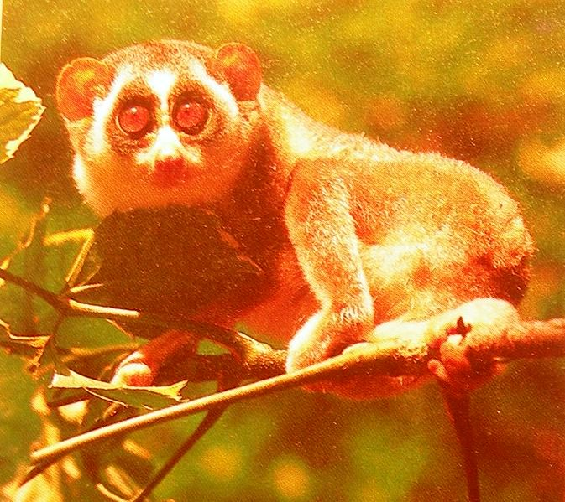
Primates - prosimians
Tarsier
Alpingstone
Loris
Lemur

Slide 8
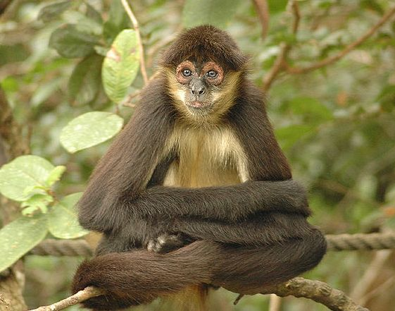
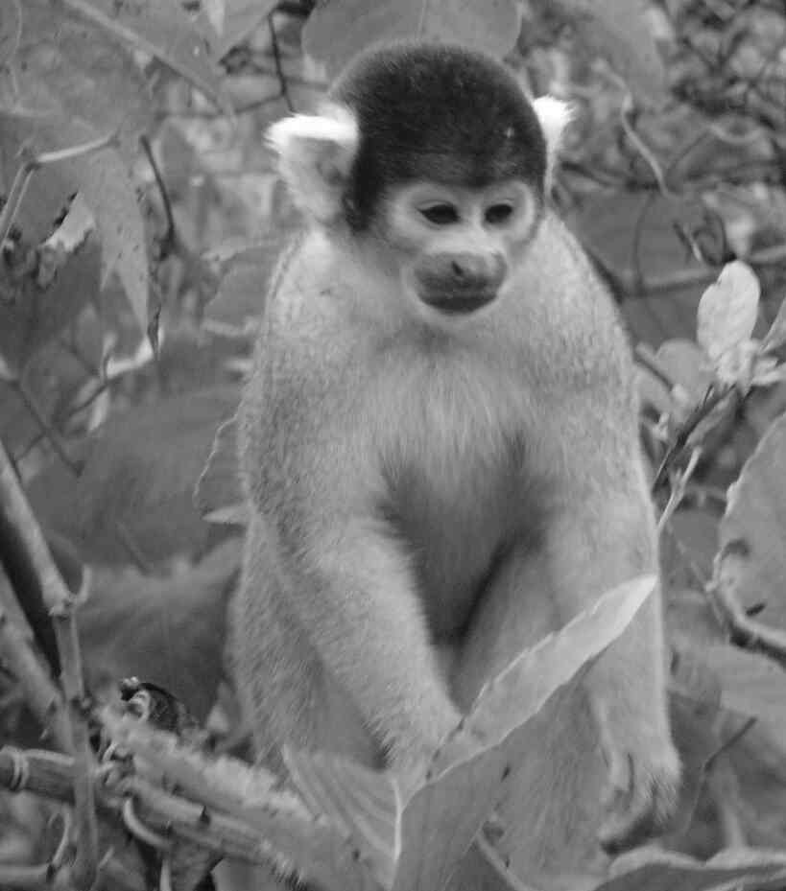
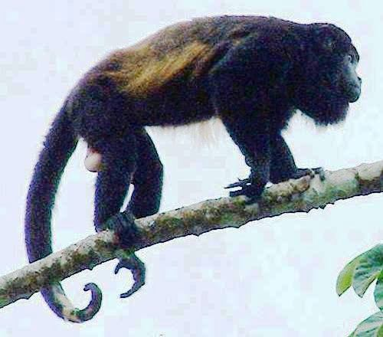
Primates – new world monkeys
Michael Schamis
Spider monkey
Howler monkey
Squirrel monkey

Slide 9
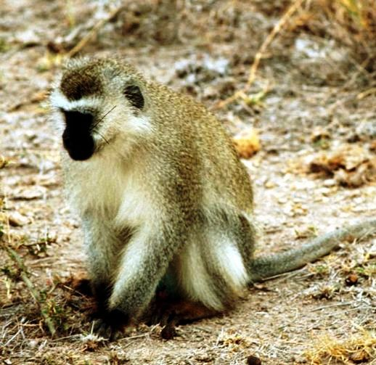
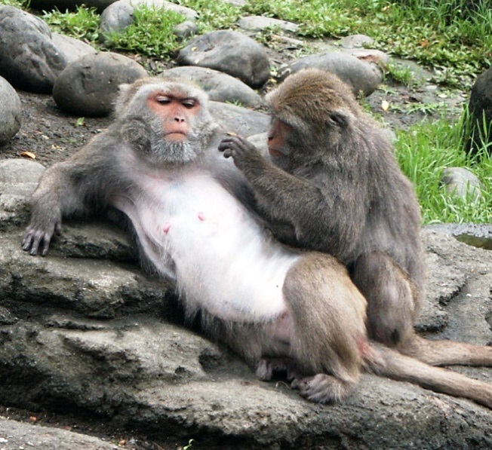
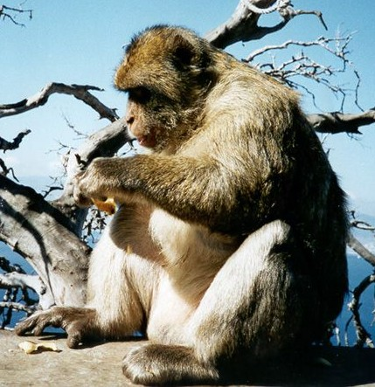
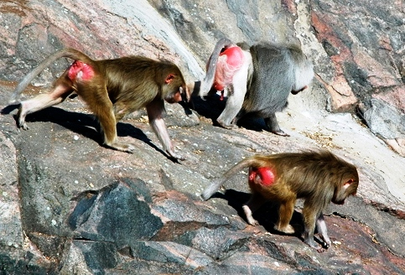
Primates – old world monkeys
Green monkey
Macaque
Barbary ape
Baboons

Slide 10
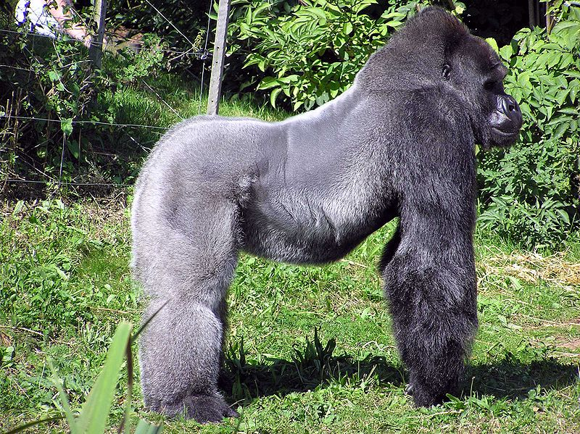
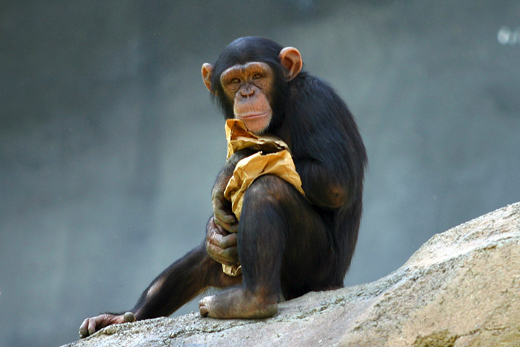
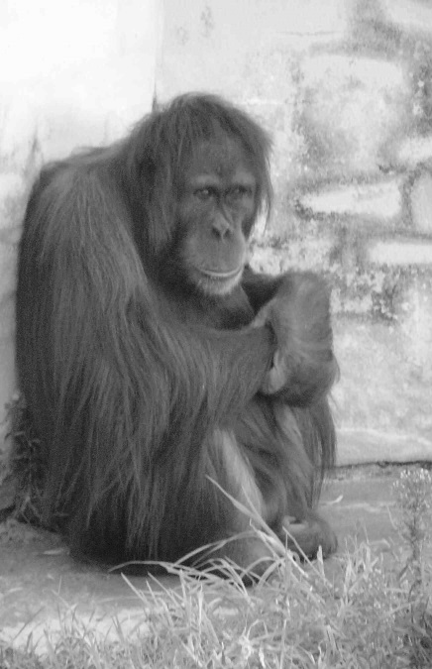
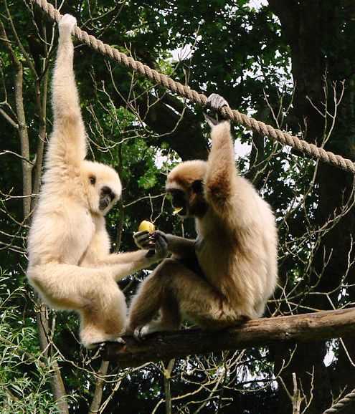
Primates - apes
Arpingstone
Chimpanzee
Gorilla
Gibbons
Orang utan
Notes:
Gibbons are referred to as lesser apes.

Slide 11
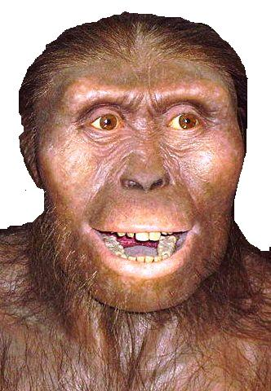
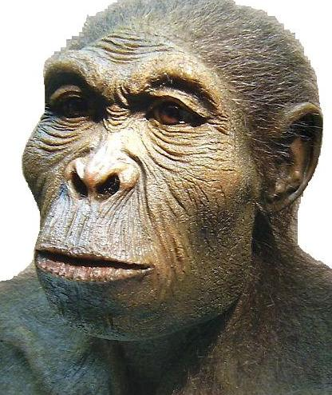
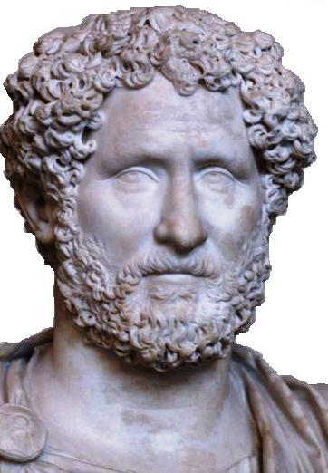
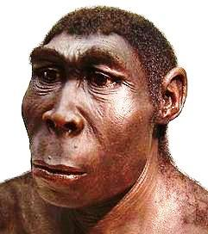
Primates - hominids
Australopithecus
Homo habilis
Homo sapiens
Homo erectus

Slide 12
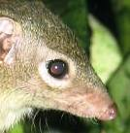
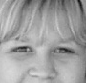
Primate evolutionary trends
Eyes move towards front of face – better 3-D (stereoscopic) vision.
Better colour vision
Reduced sense of smell

Slide 13
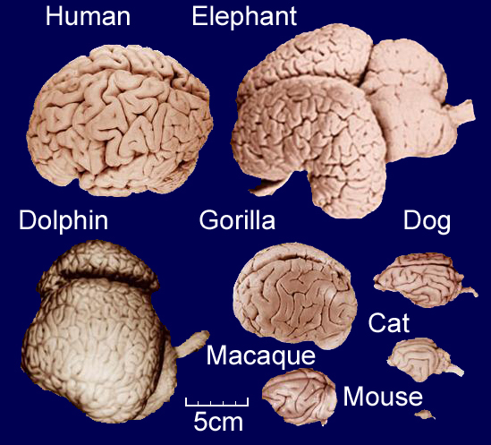
Large brain relative to the size of the body
Notes:
Size does matter but so do the number of convolutions (folds) as these increase the surface area.

Slide 14
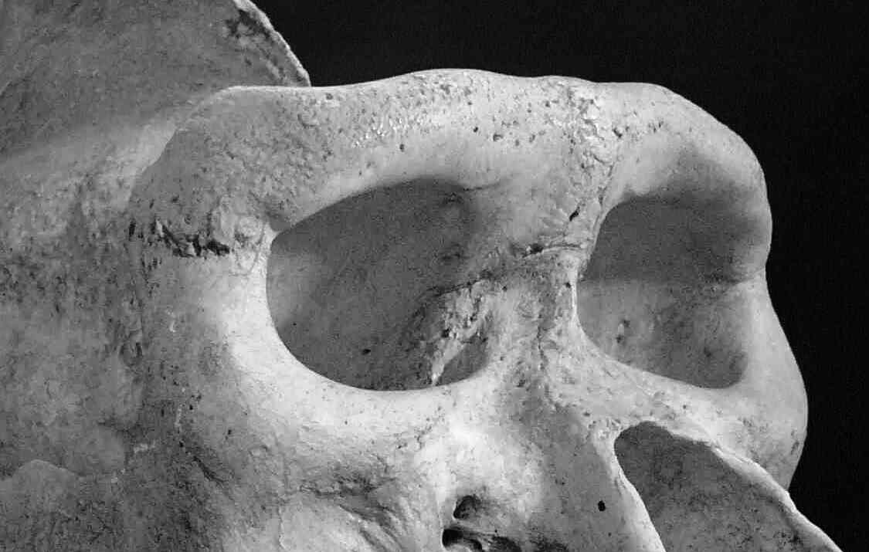
Completely enclosed orbit protects the eyes.

Slide 15
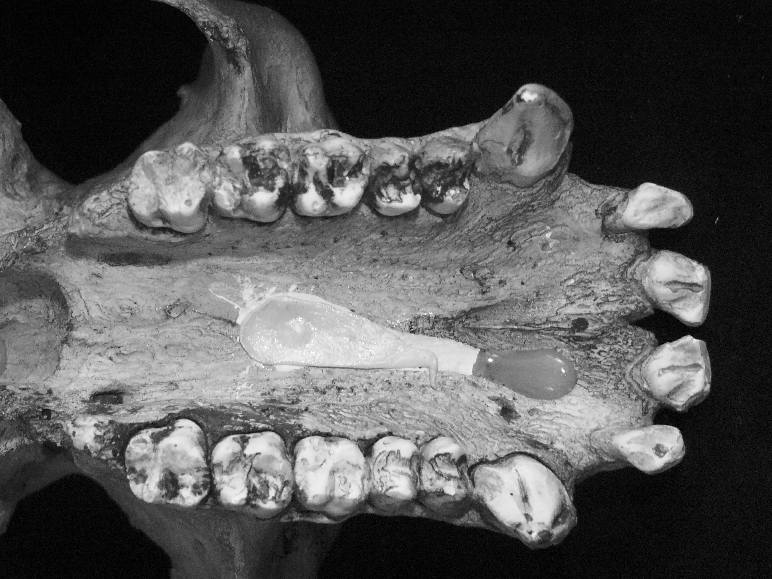
Generalised dentition with reduced tooth numbers (I2:C1:PM2/3:M3)
Notes:
Note the diastema between the canines and incisors.

Slide 16
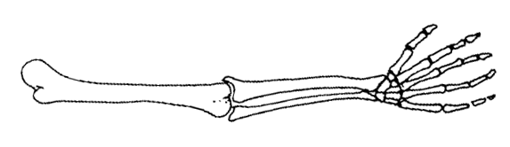
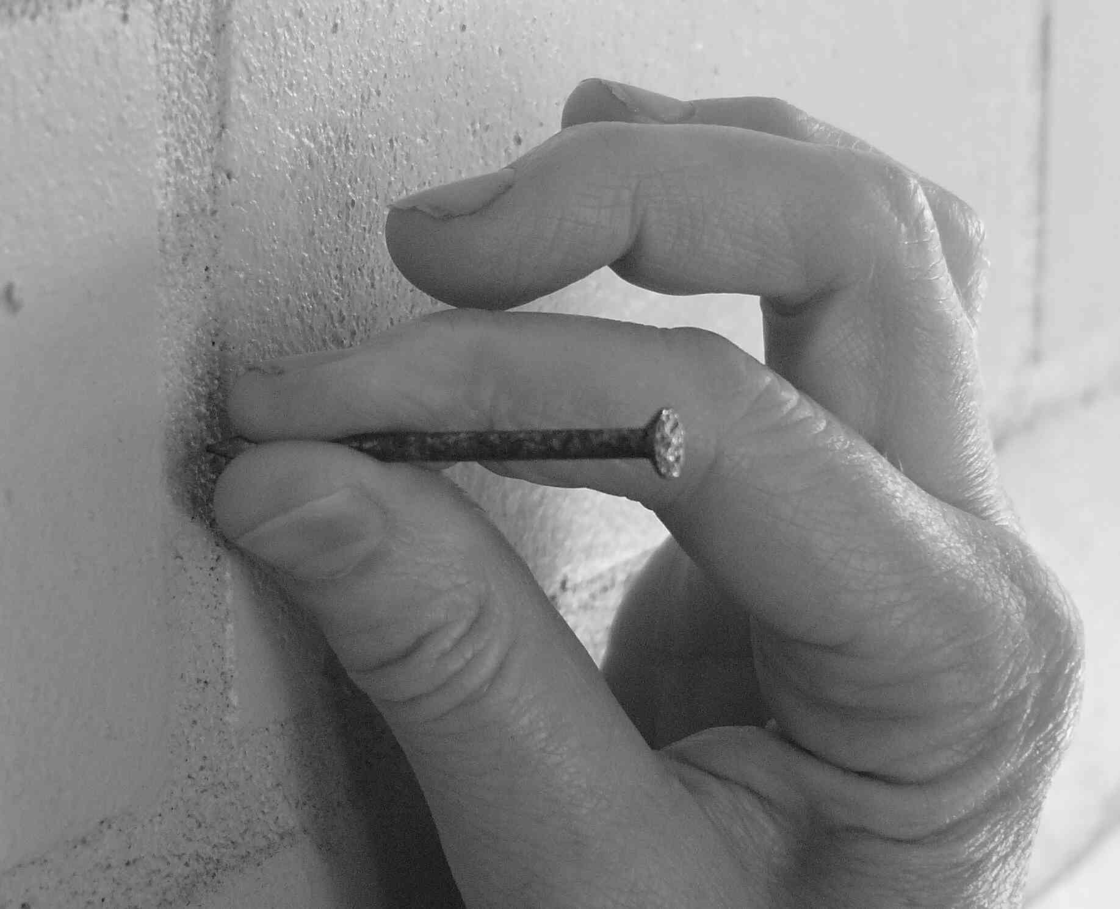
Generalised pentadactyl limbs with improved grasp (opposability of thumb)
Notes:
Friction ridges (fingerprints) also help with gripping.

Slide 17
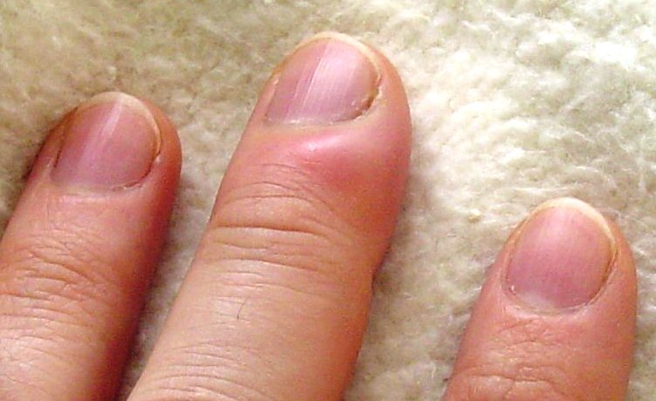
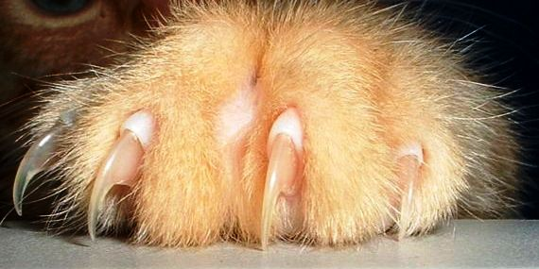
Nails replace claws
Notes:
These enable primates to grasp. Very useful if one is arboreal such as gibbons.

Slide 18
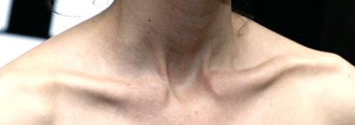
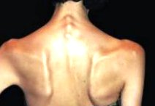
Primate evolutionary trends - 2
Mobile fore-limbs – shoulder blade on back & well developed collar bone
Notes:
This also places our forelimbs to the side rather than in front like a dog’s.

Slide 19
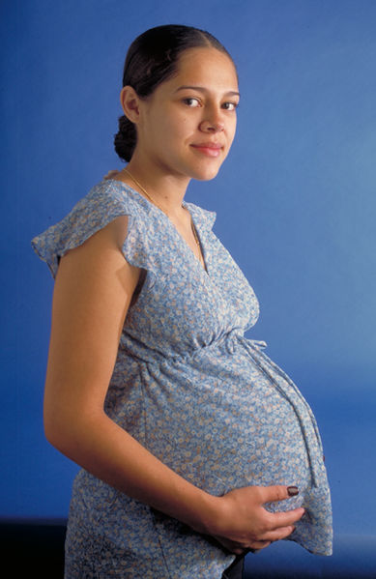
Single pregnancies
Extended period of dependency on parents
Body tends to get larger

Slide 20
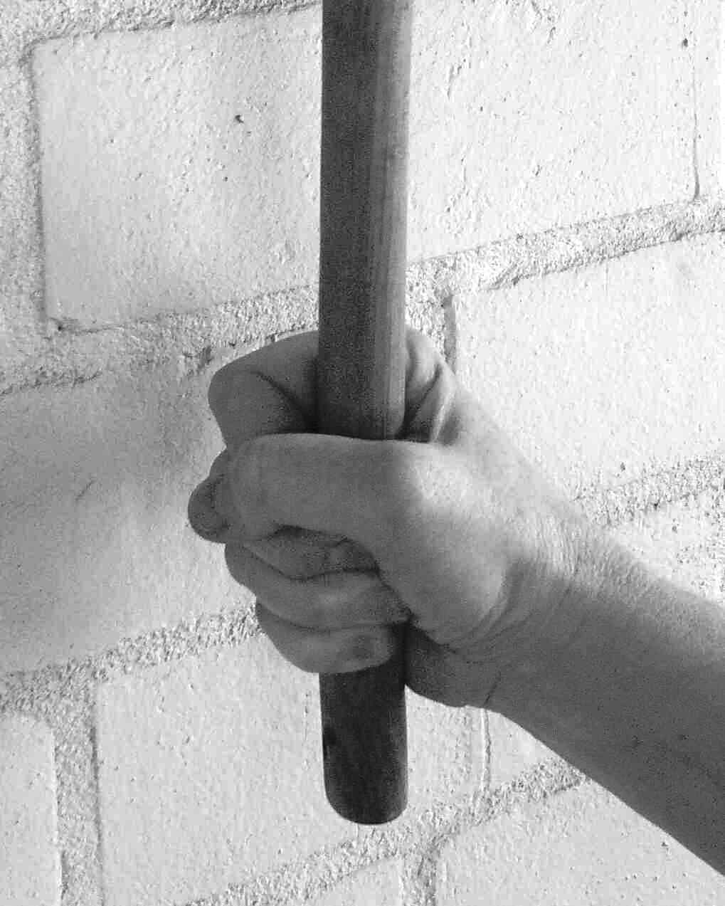
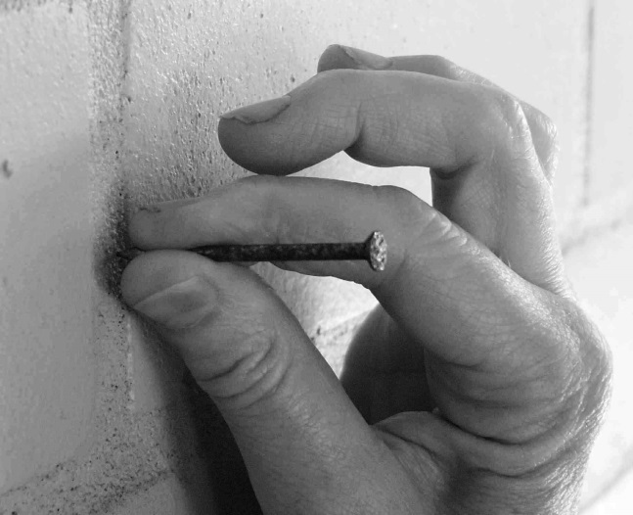
Opposability of the Digits
Precision grip
Power grip
Changes to the relative length of the forefinger and thumb, and modification of the musculature and joints of the hand have improved the opposability of the thumb and the range of grips available to humans.
In contrast, the big toe has largely lost its opposability in humans.. Other primates still have opposable toes.

Slide 21
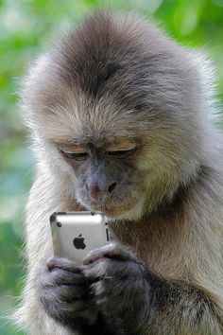
Thank goodness for opposable digits…

Slide 22
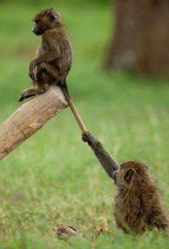
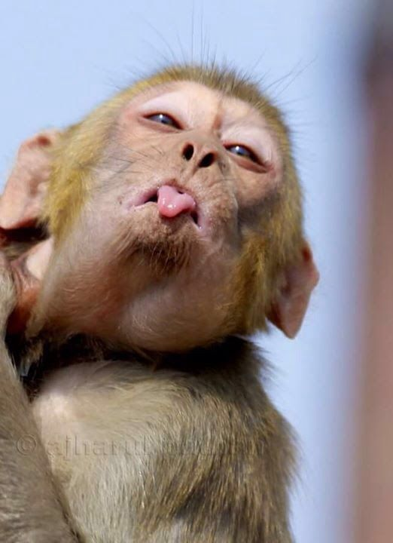
and a sense of humour

